Slide 1
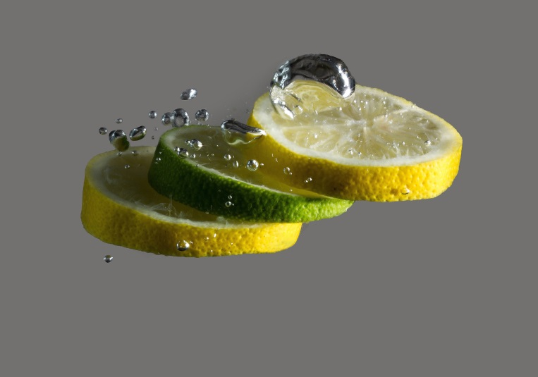
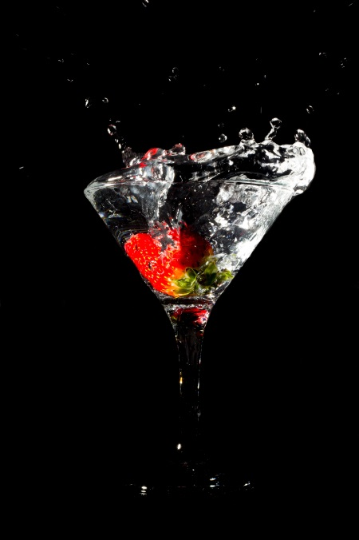
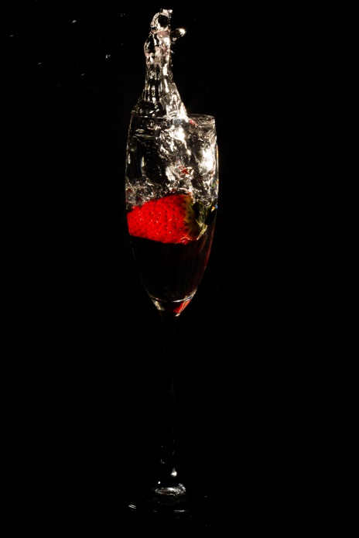
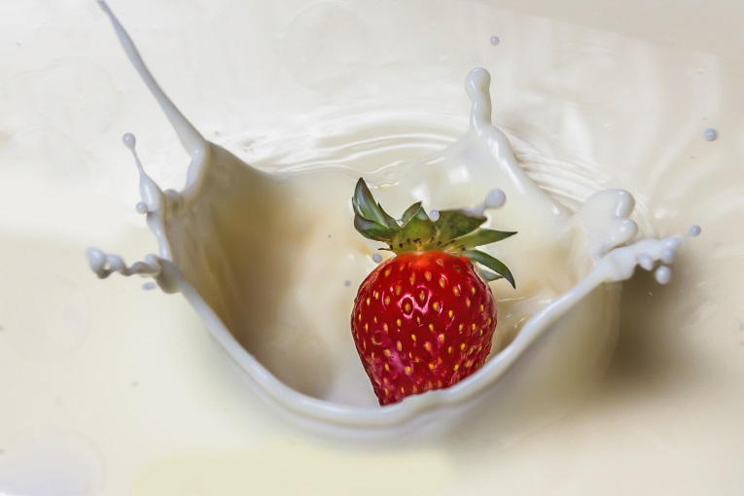
Splash photography

Slide 2
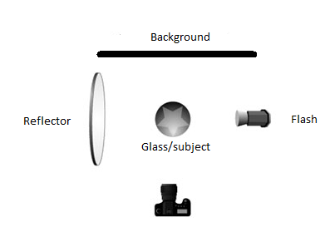
Setting up for the shot part 1
Make sure the glass you are using is clean (Microfiber cloths are fantastic for this)
Place the flash and reflector perpendicular to the camera lens and at the same height as the glass as a good starting point (a softbox gives softer light)

Slide 3
Setting up for the shot part 2
Have a clean/smooth background (you can use a sheet or cardboard etc that’s non-reflective)
Using live view mode make sure the camera and lens are at the right height to give one smooth water or glass line rather than being angled down or up (the aim is to be as perpendicular as possible)
Make sure you have towels to clean up the mess and paper towel to pat the fruit or object dry after each attempt if needed

Slide 4
Camera settings part 1
Because we’re focusing at such a short distance, getting the depth of field right is important to capture all the detail. I use an app called ‘Iperfocale’ which you can setup to calculate the exact depth of field for your specific camera and lens
You need a much smaller aperture to get the detail of all the water drops. With my setup, f16 gives me a depth of field of approximately 20cm compared to 10cm at f8

Slide 5
Camera settings part 2
I make sure I shoot in RAW as this makes post editing of the image much easier
ISO as low as possible and flash power set quite high because of the use of a small aperture. I always adjust the flash power for exposure before raising the ISO as a last resort
Shutter speed depends on your flash. Most flashes/cameras will allow you to shoot up to 1/250. I use a high-speed flash and shoot at 1/500 depending on the light.

Slide 6
Taking the shot part 1
The key here is PERSISTENCE. Be prepared to spend up to an hour and take 50+ shots to get what you want. Imagine the shot you’re after and keep going until you get it! It’s a great feeling when you do!
It will take you a few attempts to get your timing right with the drop and capture. Sometimes I use the self timer and other times I use a trigger
FOCUS on the glass or top of water line if you need something to grab onto and switch focus to manual so the camera doesn’t have to ‘think’

Slide 7
Taking the shot part 2
Make sure you review and zoom right in on your first few shots to check that they are in focus and the aperture is small enough to capture all detail
You can play around the position of the flash etc or add two flashes if you want to change the lighting or are trying to create something different. You can also try angling the flash down from directly above

Slide 8
Editing
In Adobe Camera Raw I work from the top down and play with the settings until I’m happy
I then open the image in Photoshop
Here I use the brush healing tool to remove anything that doesn’t look right.
Sometimes I use the colour picker and a brush to smooth out the background depending on how the shot came out. Zooming right in is important

