Slide 1
The Triad
Understanding
Shutter Speed, Aperture and ISO
The first steps

Slide 2
Who are we?
A little about Di
A little about us
Notes:
Di’s background and interests
The laundry room
Camera Club
The issues between digital and film – control was lost
Now – support and resources

Slide 3
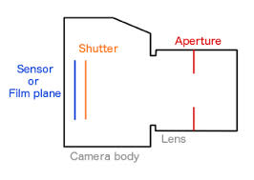

Slide 4
Shutter Speed
Determines how long the shutter will stay open.
The longer the shutter stays open the more light hits the sensor.

Slide 5
Shutter speed is similar to your eyelid opening and closing.
Depending on the light your eyelid will flutter quickly or slowly

Slide 6
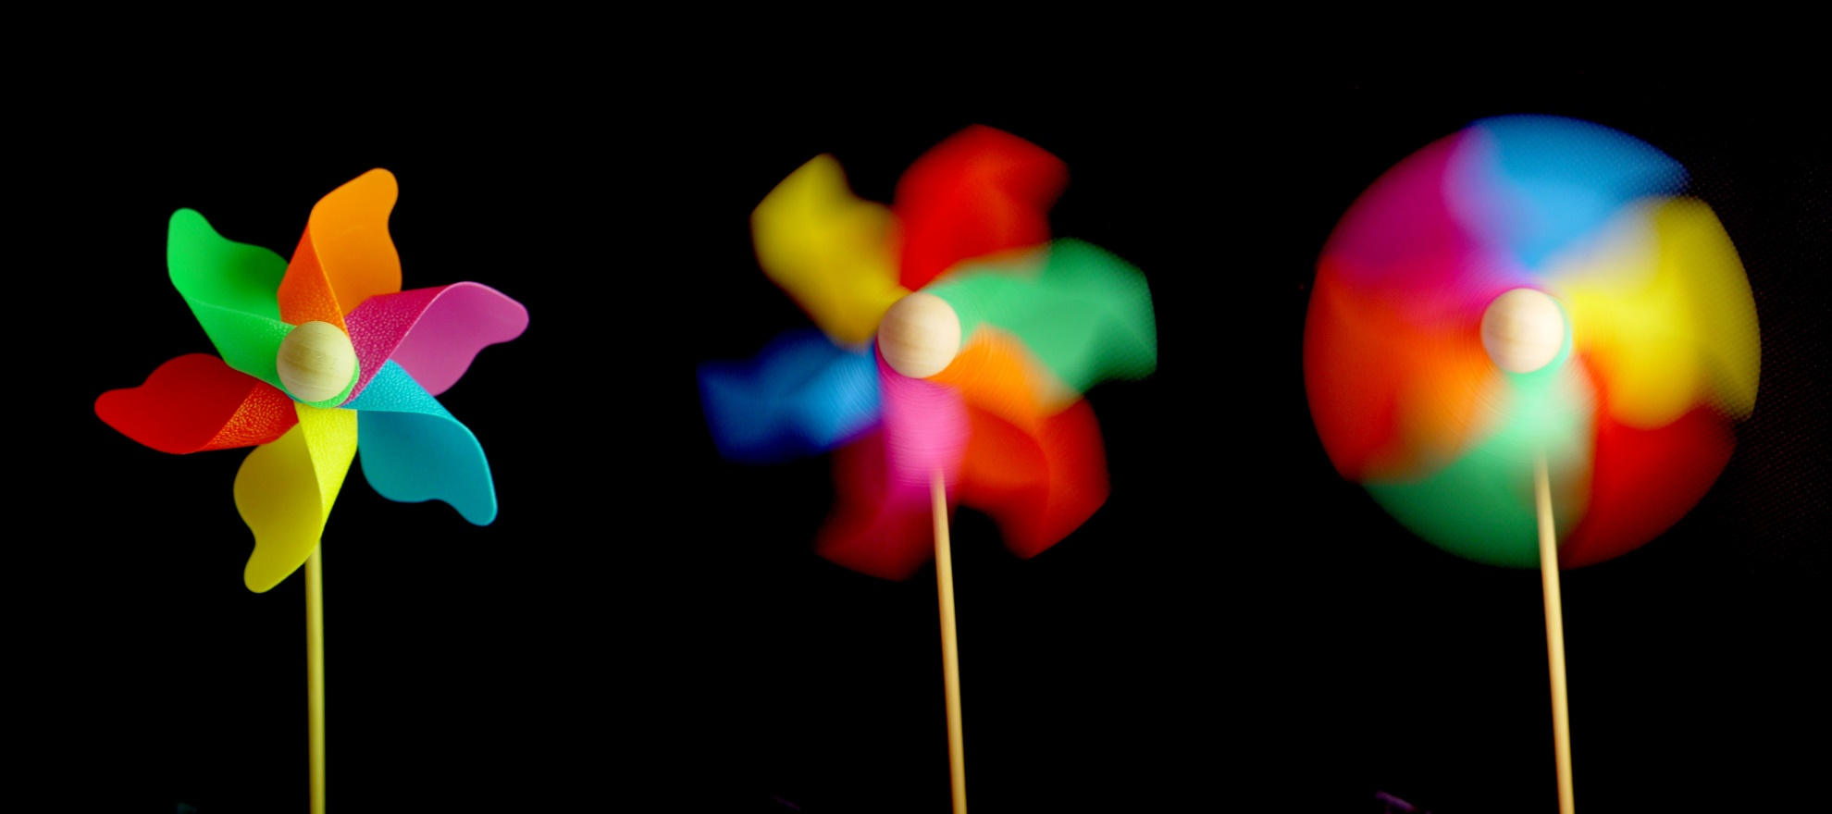
The Result

Slide 7
Aperture
When you hit the shutter release button of your camera a hole opens up that allows your cameras image sensor to catch a glimpse of the scene you’re wanting to capture.

Slide 8
Aperture
The aperture that you set impacts the size of that hole. The larger the hole the more light that gets in – the smaller the hole the less light.
Aperture is measured in ‘f-stops’

Slide 9
The "depth" in depth of field is the distance between the nearest sharp object and the farthest sharp object in your image

Slide 10
The function of the aperture ring is not unlike how your Iris responds to light naturally.
A lot of light = small Iris
A little light = big Iris

Slide 11
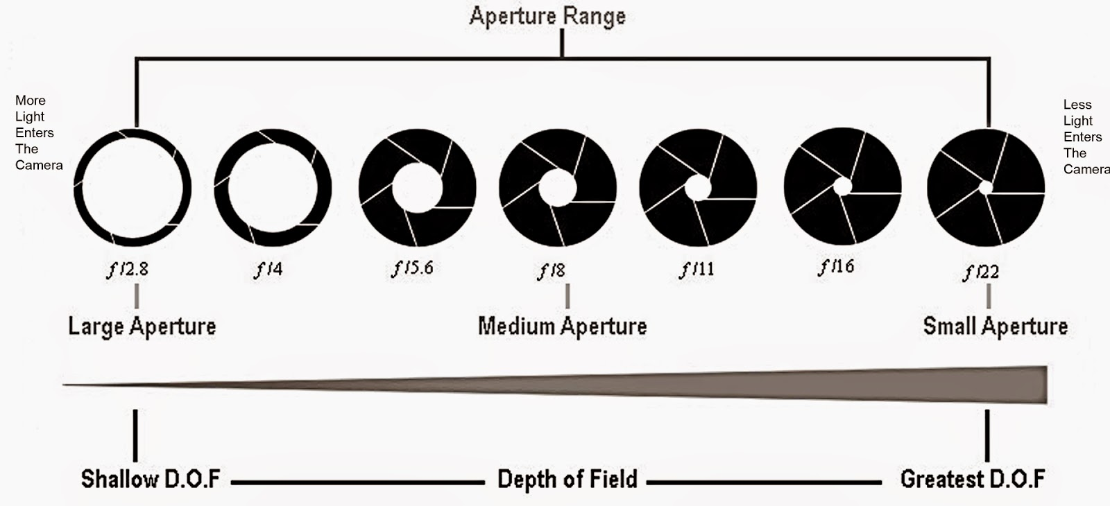

Slide 12
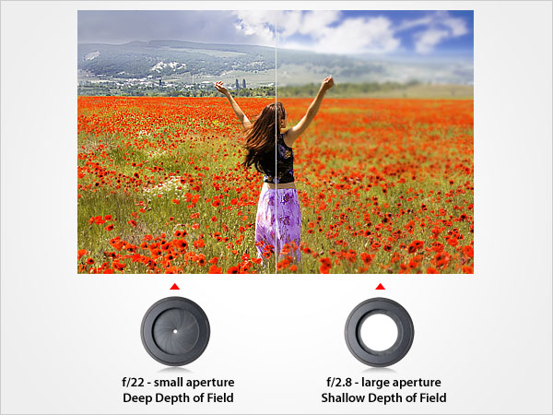
The Result
Notes:
http://www.exposureguide.com/focusing-basics.htm retrieved 20150628

Slide 13
ISO
This is a measurement of how sensitive your film or digital sensor is to light

Slide 14
The lower the ISO number, the less sensitive it is to the light, while a higher ISO number increases the sensitivity of your camera.
The component within your camera that can change sensitivity is called “image sensor” or simply “sensor”.

Slide 15
It is the most important (and most expensive) part of a camera and it is responsible for gathering light and transforming it into an image.

Slide 16
With increased sensitivity, your camera sensor can capture images in low-light environments without having to use a flash.
But higher sensitivity comes at an expense – it adds grain or “noise” to the pictures.

Slide 17
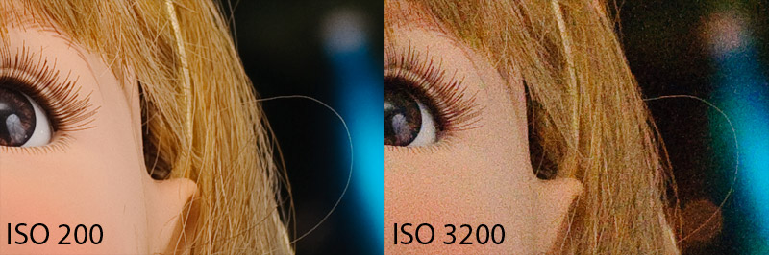
The Result

Slide 18
We can’t finish here without mentioning
Bokeh

Slide 19
In photography, bokeh (Originally /ˈboʊkɛ/, /ˈboʊkeɪ/ BOH-kay — also sometimes pronounced as /ˈboʊkə/ BOH-kə, Japanese: [boke]) is the aesthetic quality of the blur produced in the out-of-focus parts of an image produced by a lens. Bokeh has been defined as "the way the lens renders out-of-focus points of light".
Bokeh - Wikipedia, the free encyclopedia
https://en.wikipedia.org/wiki/Bokeh

Slide 20
Remember, bokeh is rendered by the lens, not the camera
Bokeh is also known as Background Blur

Slide 21


Slide 22
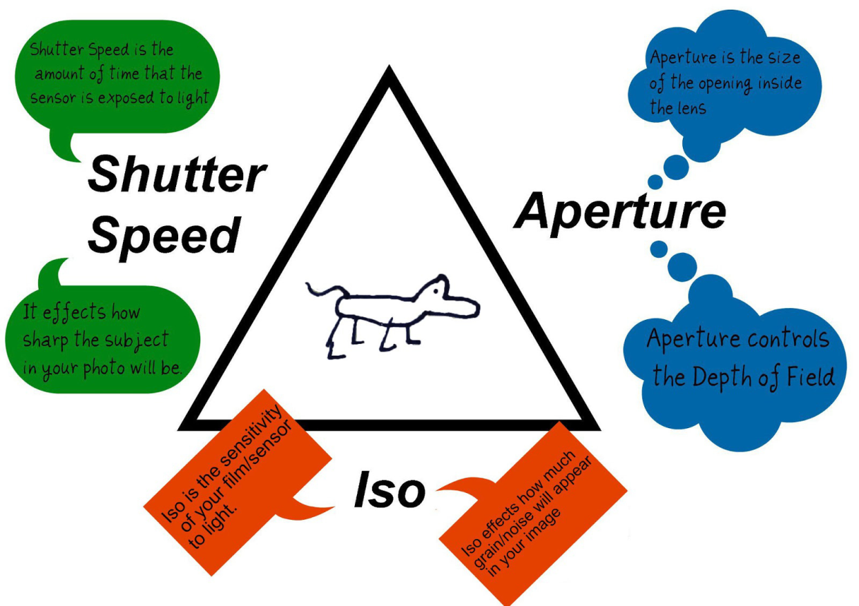
Re-Cap
Notes:
http://www.stevehuffphoto.com/tag/aperture/ retrieved 28062015

Slide 23
Resources and Great Reads
http://www.stevehuffphoto.com/tag/aperture/
http://theweathereddoor.blogspot.com.au/2015/03/photography-tips-and-camera-body-lenses.html
http://www.exposureguide.com/focusing-basics.htm
https://photographylife.com/what-is-iso-in-photography

